Slide 1

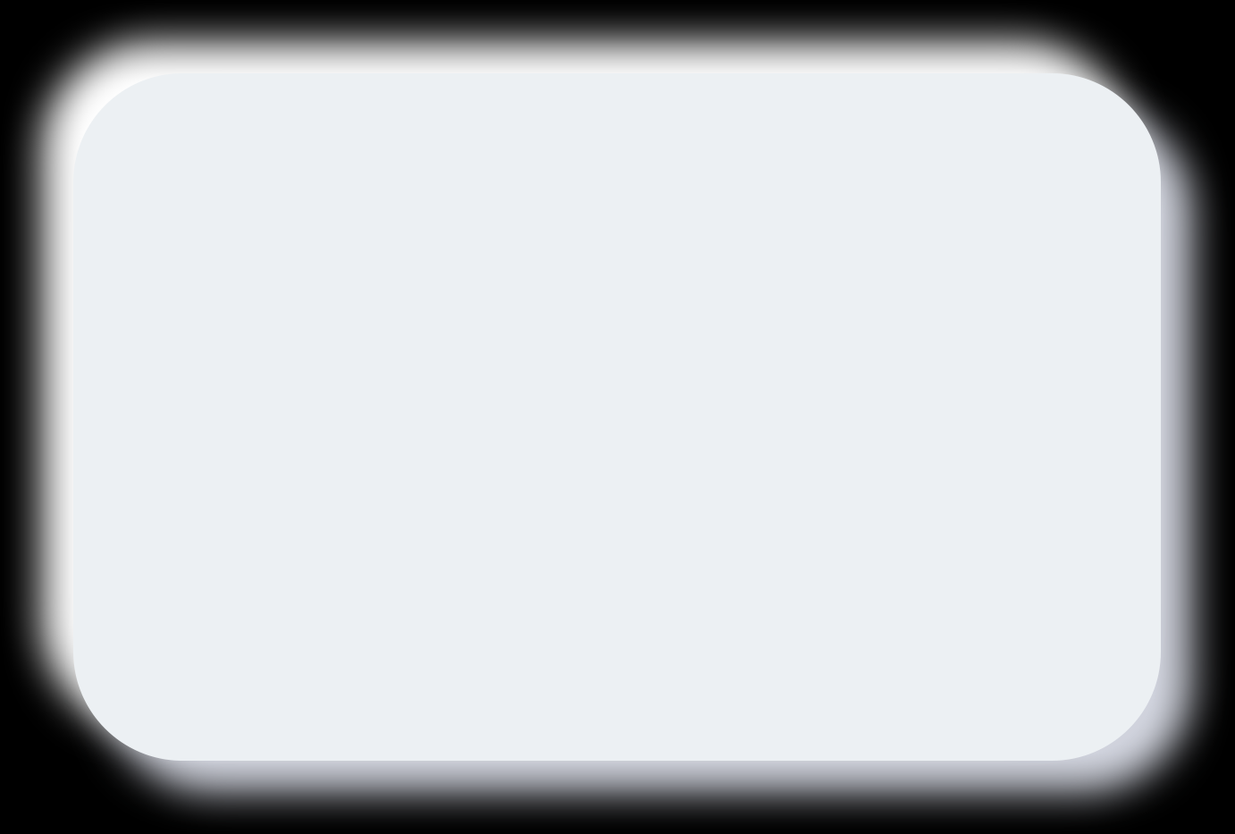


IMSAXES Automation Project
Ayush Dipakbhai Patel | 220170116031 | Programmer Analyst | VGEC, Chandkheda

Slide 2

Internship Introduction
Internship at Meditab Software Pvt. Ltd. as a Programmer Analyst in the IT Department during the 8th Semester under VGEC. The project focuses on automation in healthcare software testing, aimed at improving quality assurance processes for medical software solutions.

Slide 3
About Meditab Software Pvt. Ltd.
Founded in 1998, Meditab Software specializes in healthcare technology solutions with over 2600+ employees worldwide. The company is ISO 9001:2015 certified.
Global presence with offices in USA (Headquarters), India, Philippines, and Argentina, delivering innovative healthcare software solutions internationally.

Slide 4

Meditab's Main Product: IMS
Intelligent Medical Software (IMS) is a comprehensive multispecialty EHR and practice management system designed for modern healthcare.
Supports clinics and hospitals with integrated healthcare management, focusing on quality, scalability, and innovation.

Slide 5
IMSAXES Project Overview
• Project: IMSAXES (Automation Execution Environment IMS)
• Aim: Build scalable automation frameworks for regression testing
• Scope: Automate testing of internal web and Windows applications
• Goal: Reduce manual testing effort and improve product quality

Slide 6
Training Received
SQL: Complex queries, joins, and backend data validation techniques for database testing
Java: Object-oriented programming, exception handling, and API integration for automation scripts

Slide 7
Technologies and Tools Used
Programming: Java, JavaScript
IDE & Tools: Eclipse IDE, UFT
Frameworks: Maven, TestNG, Selenium WebDriver
Reporting: Extent Reports
Web Technologies: React.js, Express.js, Node.js
Databases: PostgreSQL, MySQL

Slide 8
Project Objectives
Maximize test coverage with minimal human effort through automated execution frameworks and parallel batch processing.
Enable quick feedback during CI/CD cycles, ensure application reliability, and reuse scripts across modules and clients.

Slide 9

Key Features Developed
• Automated fault tolerance and recovery with robust exception handling mechanisms
• Orchestrated execution on dedicated Windows VMs with batch support for parallel testing
• Intelligent telemetry and centralized logging for comprehensive failure analysis
• Data visualization via user-friendly dashboards and automated screenshots

Slide 10
IMSAXES Portal Components
Secure React-based web interface with JWT authentication. Configuration, server and suite selection capabilities.
Real-time execution telemetry via Socket.IO for live monitoring. MySQL backend database for comprehensive tracking and reporting.

Slide 11
Development Approach
Phase 1: Initiation and strategy setup
Phase 2: Requirements analysis and test planning
Phase 3: Knowledge transfer and scenario design
Phase 4: Environment and platform setup
Phase 5: Script design and automation workflow
Phase 6: Execution and final delivery
Phase 7: Maintenance and continuous improvement

Slide 12
Testing Strategy
Functional Testing: Login workflows, task management verification, and core feature validation across modules.
Performance Testing: Load and stress simulation with network condition testing to ensure system reliability under heavy usage.

Slide 13

Achievements and Outcomes
Critical time savings achieved through parallel batch executions across multiple VMs. Reduced manual errors significantly in environment setup and test configuration.
Increased productivity via centralized dashboards for monitoring. Consistent testing across builds with improved coverage and quality. Enhanced test maintainability and efficiency.

Slide 14
Limitations
Cannot replace exploratory testing and human intuition-based testing approaches that require creative thinking and domain expertise.
Windows UI volatility requires regular script maintenance due to frequent interface updates and element changes.

Slide 15
Future Enhancements
AI-assisted test generation from BDD inputs to automatically create test scripts from behavior-driven specifications.
Predictive AI-driven mock data generation and automated performance CI/CD integration with predictive dashboard analytics for anomaly detection.

Slide 16
Roles and Responsibilities
• Requirement gathering and analysis for automation test scenarios
• Designing and developing automation scripts for IMSAXES framework
• Executing test suites and generating comprehensive test reports
• Designing automation workflows for sanity and regression testing
• Creating and maintaining technical documentation
• Knowledge transfer sessions with team members

Slide 17

You
Thank

